Slide 1



Counter Intel Workshop
Codename: MASKIROVKA WINTER

Slide 2
INTRO
Dan
Pen Tester/Red Teamer
IA/CTI Enthusiast
Postgraduate student at CSU AGSPS
AIPIO Member
@iTzDan1337
Slack = @dank

Slide 3
Maskirovka Winter: A counter intelligence exercise
An energy substation situated in Grozny, Chechnya has been the target by unknown actor who’ve disrupted major electric feeders affecting hundreds of thousands of Russian and Georgian citizens. Without this energy the loss of human life is high as citizens struggle to survive.
Russian Special Communications directorate has issued an advisory proclaiming Russian critical infrastructure are under targeted attacks prompting military forces to mobilise on eastern borders for military response.
President Ngordov of Georgia has ordered the Air Force on high alert as several radar detections of unidentified craft entering Georgian airspace from Dagestan. NATO JISR have detected Ukraine Armed forces mobilising at flashpoint zones Luhansk and Yuhanivka.
World war 3 is imminent.
You are a cyber intelligence analyst at the Department of Defiance assigned to search, track and reveal the truths surrounding the event. Your intelligence reports are critical for decision makers to form the appropriate response.

Slide 4
Sim Scoring
Register ctf.electropultgrozny.net
Data files accessible here usb
Flag submissions via ctf page, for theory models mailto:
Points are varied depending on complexity for the other submissions via (timeliness, quality and merit)

Slide 5
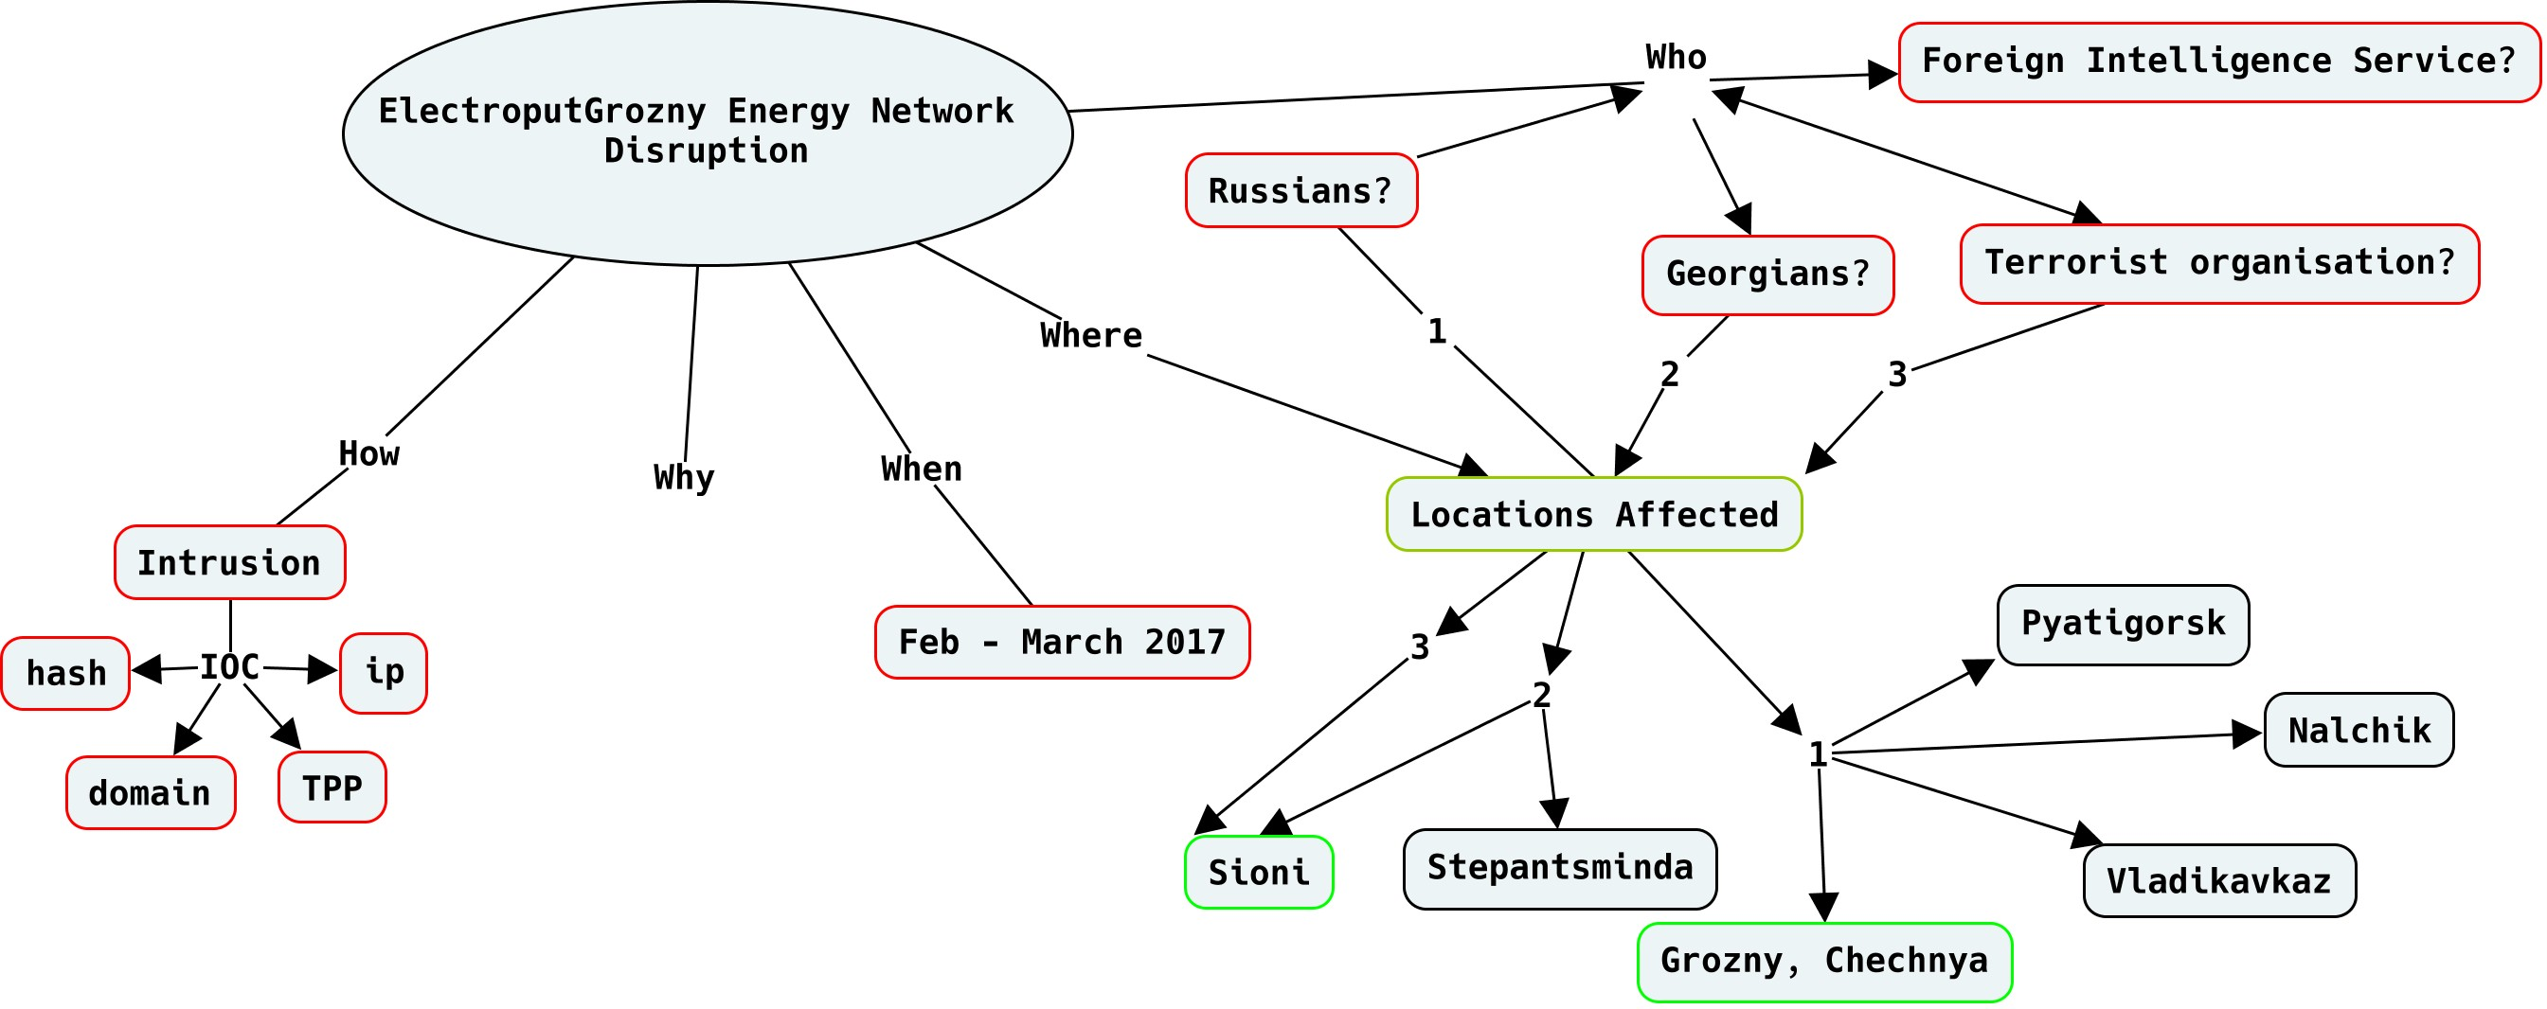
STAGE 1

Slide 6
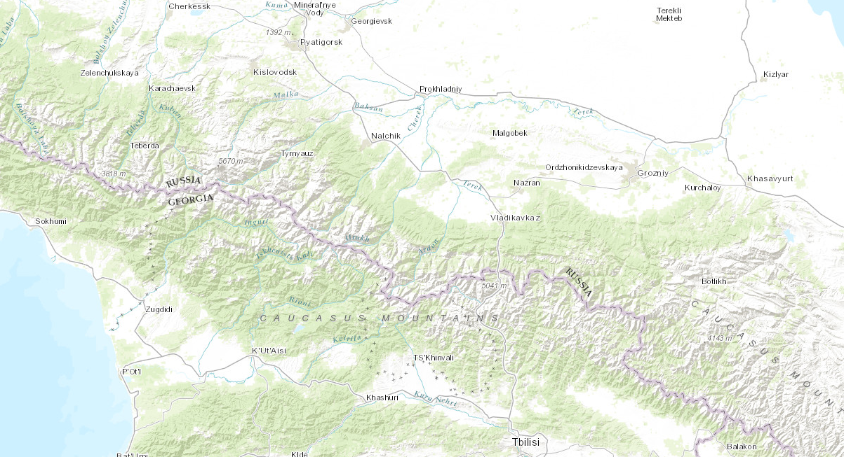
STAGE 1: GROZNY
IMPACT ZONE

Slide 7
Challenges
Compromised Host Image
- 1. Identify technique used
- 2. Identify processid of malware
- 3. MD5hash of the process
- 4. Dropper Address
- 5. Persistence mechanism
Stats
- 1. What were the significant financial transactions?
- 2. Who made them and why?
- 3. Identify key IOCs related to the Electroput Grozny using open source threat intel feeds
Packet Capture
- 1. Review NATO and RU network packet captures and build a timeline of activity
- 2. What diffusion tactics were used?
- 3. Identify agent comms method and C2 Addresses
Network Study
- 1. Build a map and identify significant clusters
- 2. Determine relative links and their closeness centrality
- 3. Produce an informed predictive model of the Maskirovka network cell
- 4. Determine cell network members and their role

Slide 8
Core Aspects
How attackers gained access
How attackers maintained access
What was their purpose
Are they still here?
Determine the profile and sophistication level of the attack.
1. Determine how program interact with network.
2. Determine how program interact with the host system.
3. Determine the infection mechanism.

Slide 9
Some tools opensource/freeware
Google APT
Annomalli STAXX
RiskIQ PassiveTotal
ThreatMiner
ThreatCrowd
OTX
Combine/YETI
Maltego
CMAP
Gephi
Elasticsearch + Kibana
Volatility
Mandiant Memoryze, Redliner
Wireshark
CRITS

Slide 10
Transforming data into intel
Requirements
Collection
Collation
Synthesis (Data manipulation and processing)
Analysis
Modelling (Prescriptive, Descriptive, Predictive)
Reporting & Dissemination

Slide 11
Intelligent Analysis fundamentals
(context (information + analysis = intelligence
insight > reduces uncertainty))
Intent (desire + expectation)
Capability (knowledge + resources)
Axioms & Problem formulation
Reasoning (inference, deference)

Slide 12
Counter Intelligence Analysis fundamentals
Used to disrupt, deny, degrade, deceive and divert efforts of a foreign intelligence service from acquiring intelligence
CI used Offense and Defense

Slide 13
Operational Intelligence as a function
Consuming CTI
OTX, Virustotal, ThreatMiner,
PassiveTotal and ThreatConnect
STIXX/TAXI
OSSIM and CRITS
Generation CTI
Kill Chain/Intrusion Analysis
Yara
Cybox
CRITS
IDS Signatures

Slide 14
Social Network Analysis
Mapping and measurement of relationships and interactions between entities
Finds patterns
Nodes (People, organisations, entities)
Relationships (Ties connections or edges) between nodes
Output is Mathematical and Visual
Centrality is the critical factor, prominence of them acting within the network

